Slide 1
Transport Layer Part II: TCP

Slide 2
Where are we now?
Introduction to Networking
Basic Queuing Theory
Application Layer
Transport Layer
Network Layer and Routing
Data Link Layer
Medium Access Control SubLayer
Physical Layer
Further subjects (we will decide what to talk about based on the time left at the end of the semester)

Slide 3
TCP segment structure
RELIABLE XFER:
counting
by bytes
of data
(not segments!)
32 bits
URG: urgent data
(generally not used)
source port #
dest port #
sequence number
ACK: ACK #
valid
acknowledgement number
head
len
not
used
U
Receive window
A
P
R
S
PSH: push data now
(generally not used)
F
FLOW CONTROL:
# bytes
rcvr willing
to accept
checksum
Urg data pointer
RST, SYN, FIN:
connection estab
(setup, teardown
commands)
Options (variable length)
application
data
(variable length)
Internet
checksum
(as in UDP)

Slide 4
TCP reliable data transfer
TCP creates reliable service on top of IP’s unreliable service
seq # is byte-stream number of first data byte in segment
pipelined segments
cumulative ACKs
TCP uses single retransmission timer for the oldest unacked segment
retransmissions are triggered by:
timeout events
duplicate ACKs
Q: how receiver handles out-of-order segments
A: TCP spec doesn’t say, - up to implementer

Slide 5
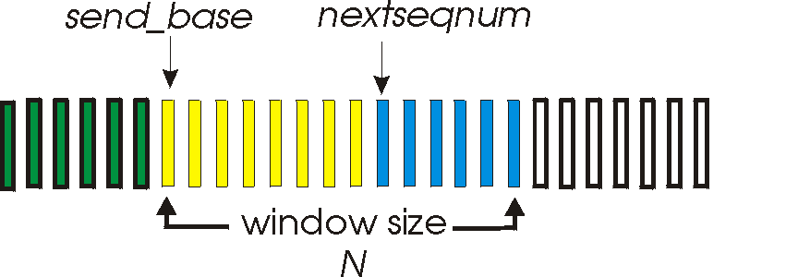
TCP Sender
loop (forever) {
switch(event)
event: ACK received, with ACK field value of y
if (y > SendBase) {
SendBase = y
if (there are currently not-yet-acknowledged segments)
start timer }
event: timer timeout
retransmit not-yet-acknowledged segment with the smallest sequence number
start timer
} /* end of loop forever */
Comment:
SendBase-1: last cumulatively ACKed byte

Slide 6
TCP sender events:
data rcvd from app:
create segment with seq #
seq # is byte-stream number of first data byte in segment
start timer if not already running (think of timer as for oldest unACKed segment)
expiration interval: TimeOutInterval
timeout:
retransmit segment that caused timeout
restart timer
ACK rcvd:
if acknowledges previously unACKed segments
update what is known to be ACKed
start timer if there are outstanding segments

Slide 7
TCP: retransmission scenarios
Host A
Host B
Host C
Host D
Seq=92, 8 bytes data
Seq=92, 8 bytes data
timeout
ACK=100
X
ACK=100
timeout
Seq=100, 20 bytes data
loss
X
loss
Seq=92, 8 bytes data
SendBase
= 120
ACK=120
ACK=100
SendBase
= 100
time
time
Cumulative ACK scenario
lost ACK scenario

Slide 8
Fast Retransmit
time-out period often relatively long:
long delay before resending lost packet
detect lost segments via duplicate ACKs.
sender often sends many segments back-to-back
if segment is lost, there will likely be many duplicate ACKs for that segment
If sender receives 3 duplicate ACKs for same data, it assumes that segment after ACKed data was lost:
fast retransmit: resend segment before timer expires
Does not restart the timer!

Slide 9
Host A
Host B
seq # x1
seq # x2
seq # x3
X
ACK x2
seq # x4
seq # x5
ACK x2
ACK x2
Start timer for x2
ACK x2
triple
duplicate
ACKs
resend seq X2
DOES NOT
restart timer for x2
Timeout for x2
seq# X6
time

Slide 10
Fast retransmit algorithm:
event: ACK received, with ACK field value of y
if (y > SendBase) {
SendBase = y
if (there are currently not-yet-acknowledged segments)
start timer
}
else {
increment count of dup ACKs received for y
if (count of dup ACKs received for y = 3) {
resend segment with sequence number y
}
a duplicate ACK for
already ACKed segment
fast retransmit

Slide 11
Delayed Acknowledgement
TCP delays transmission of ACKs for up to 500ms
Goal: Avoid sending ACK packets that do not carry data.
The hope is that, within the delay, the receiver will have data ready to be sent to the receiver. Then, the ACK can be piggybacked with a data segment
Delayed ACK is not used when packets arrive out of order

Slide 12
TCP ACK generation [RFC 1122, RFC 2581]
Case
1
2
3
4
Event at Receiver
Arrival of in-order segment with
expected seq #. All data up to
expected seq # already ACKed
Arrival of in-order segment with
expected seq #. One other
segment has ACK pending
Arrival of out-of-order segment
higher-than-expect seq. # .
Gap detected
Arrival of segment that
partially or completely fills gap
TCP Receiver action
Delayed ACK. Wait up to 500ms
for next segment. If no next segment,
send ACK
Immediately send single cumulative
ACK, ACKing both in-order segments
Immediately send (possibly duplicate)
ACK, indicating seq. # of next
expected byte
Immediate send ACK, provided that
segment starts at lower end of gap

Slide 13
TCP ACK generation Example1
Initially: receiver window=[100 - 199]
t=0ms: receive segment [100 - 109]
No new segment
send ACK110 at t=150ms (delayed ACK) (Case 1)

Slide 14
TCP ACK generation Example2
Initially: receiver window=[100 - 199]
t=0ms: receive segment [100 - 109]
t=20ms: receive segment [110 - 119]
send immediate cumulative ACK120 (Case 2)

Slide 15
TCP ACK generation Example3
Initially: receiver window=[100 - 199]
t=0ms: receive segment [100 - 109]
No new segment, send ACK110 at t=120ms (delayed ACK)
t=140ms: receive segment [120 - 129]
send immediate duplicate ACK110 (Case 3)
t=500ms: receive segment [110 - 115]
send immediate ACK116 (Case 4)

Slide 16
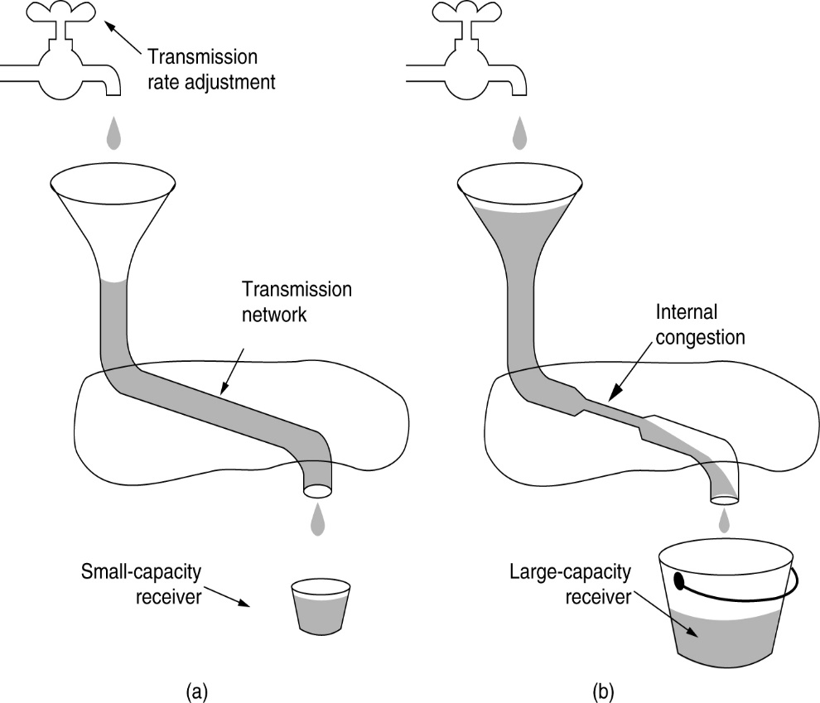
TCP Flow and Congestion Control
Problem: low capacity receiver
Solution: Flow Control
TCP Receiver tells the sender how much to send by rwnd
(b) Problem: Too much network load, high queuing delays, packet drops
Solution: Congestion Control
TCP Sender observes the ACKs to see if there is congestion by computing cwnd
Sender window limited by
w=min(cwnd,rwnd)
rate =
w
bytes/sec
RTT

Slide 17
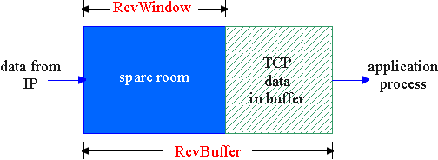
TCP Flow Control
Rcvr advertises spare room by including value of RcvWindow in segments
Sender limits unACKed data to RcvWindow
guarantees receive buffer doesn’t overflow
(Suppose TCP receiver discards out-of-order segments)
spare room in buffer
RcvWindow: rcwnd
= RcvBuffer-[LastByteRcvd - LastByteRead]

Slide 18
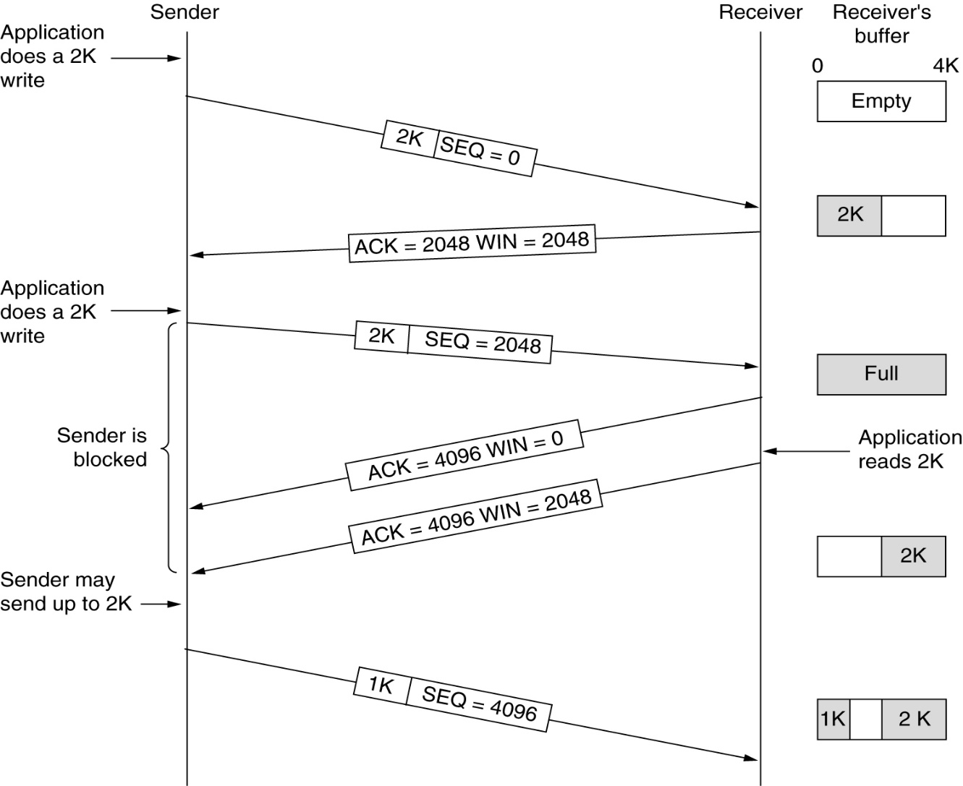
TCP Flow Control and Reliable Transfer
Seq. #’s:
byte stream “number” of first byte in segment’s data
ACKs:
seq # of next byte expected from other side
cumulative ACK
Window management in TCP.

Slide 19
TCP Congestion Control
goal: TCP sender should transmit as fast as possible, but without congesting network
Q: how to find the maximum rate just below congestion level
Solution: sender limits rate by limiting number of unACKed bytes “in pipeline”:
LastByteSent-LastByteAcked ≤ min(cwnd, rwnd)

Slide 20
TCP Congestion Control
End-end congestion control:
no explicit feedback from network
congestion inferred from end-system observed loss, delay
Decentralized: each TCP sender sets its own rate, based on implicit feedback:
ACK: segment received (a good thing!), network not congested, so increase sending rate
lost segment: assume loss due to congested network, so decrease sending rate

Slide 21
TCP congestion control: bandwidth probing
“probing for bandwidth”: increase transmission rate on receipt of ACK, until eventually loss occurs, then decrease transmission rate
continue to increase on ACK, decrease on loss (since available bandwidth is changing, depending on other connections in network)
ACKs being received,
so increase rate
X
loss, so decrease rate
Q: how fast to increase
/decrease?
X
X
X
TCP’s
“sawtooth”
behavior
sending rate
X
time

Slide 22
TCP Congestion Control
How does sender perceive congestion?
loss event = timeout or 3 duplicate acks
TCP sender reduces rate (cwnd) after loss event
Mechanisms:
Initial Rate Increase to find the available rate:
Slow Start (exponential increase until threshold)
Congestion Avoidance (linear increase after threshold)
Fluctuating around the available rate: Additive Increase Multiple Decrease (AIMD)

Slide 23
TCP Slow Start
When connection begins, cwnd = 1 MSS
Example: MSS = 500 bytes & RTT = 200 msec
initial rate = 20 kbps
Available bandwidth may be >> MSS/RTT
desirable to quickly ramp up to respectable rate
When connection begins, increase rate exponentially fast until first loss event
double cwnd every RTT
done by incrementing cwnd for every ACK received
Summary: initial rate is slow but ramps up exponentially fast
Host A
Host B
one segment
RTT
two segments
four segments
time

Slide 24
TCP Congestion Control: more details
ACK received: increase cwnd
slowstart phase:
increase exponentially fast (despite name) at connection start, or following timeout
Threshold:
Window size to Switch from exponential increase to linear increase
Initially set, dynamically updated
congestion avoidance:
increase linearly after threshold size is reached

Slide 25
Noticing congestion early
Philosophy:
3 dup ACKs indicates network capable of delivering some segments
timeout before 3 dup ACKs is “more alarming”
After timeout event:
cwnd instead set to 1 MSS;
window then grows exponentially to a threshold, then grows linearly
Refinement: After 3 dup ACKs:
cwnd is cut in half
window then grows linearly
Remember: fast retransmit If sender receives 3 ACKs for the same data, it supposes that segment after ACKed data was lost, retransmits segment before timer expires

Slide 26
TCP Congestion Control
Threshold initialized
When cwnd is below Threshold
→ sender in slow-start phase, cwnd grows exponentially
When cwnd is above Threshold
→ sender is in congestion-avoidance phase, cwnd grows linearly (Additive Increase Multiplicative Decrease)
When a triple duplicate ACK occurs
→ threshold set to cwnd/2 and cwnd=cwnd/2, then cwnd grows linearly (TCP RENO)
When timeout occurs
→ threshold set to cwnd/2 and cwnd is set to 1 MSS, then cwnd grows exponentially (Back to slow start)

Slide 27
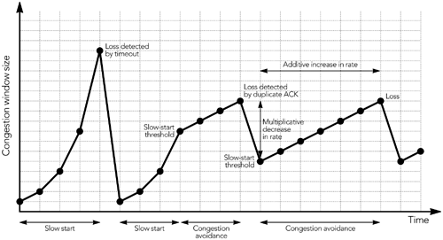
TCP Congestion Control

Slide 28
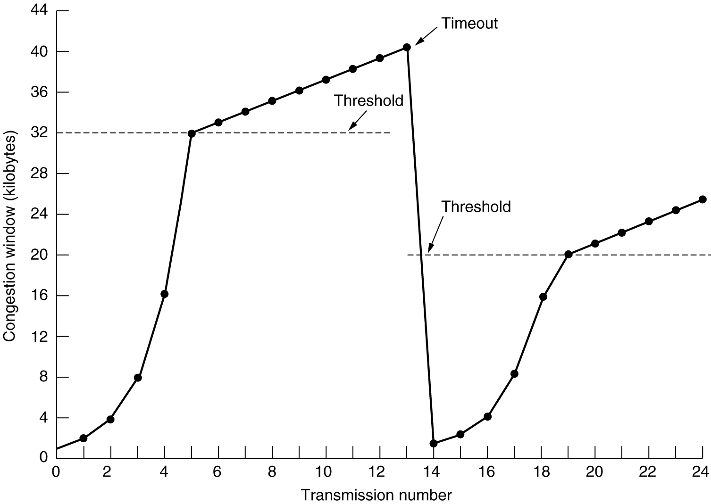
TCP Congestion Control Example 1
cwnd is above Threshold
→ congestion-avoidance phase, cwnd grows linearly
cwnd is below Threshold
→ slow-start phase, cwnd grows exponentially
When timeout occurs
→ threshold set to cwnd/2 and cwnd is set to 1 MSS, then cwnd grows exponentially

Slide 29
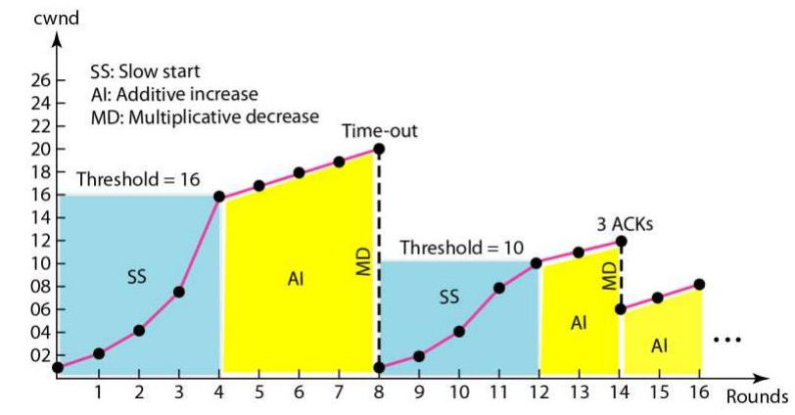
TCP Congestion Control Example 2

Slide 30
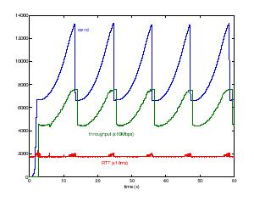
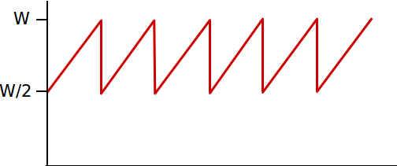
TCP throughput
Q: what’s average throughout of TCP as function of window size, RTT?
ignoring slow start
let W be window size when loss occurs.
when window is W, throughput is W/RTT
just after loss (triple ack), window drops to W/2, throughput to W/2RTT.
average throughput: .75 W/RTT

Slide 31
TCP Fairness
fairness goal: if K TCP sessions share same bottleneck link of bandwidth R, each should have average rate of R/K
TCP connection 1
TCP
connection 2
bottleneck
router
capacity R
Two competing sessions:
Additive increase gives slope of 1, as throughput increases
multiplicative decrease decreases throughput proportionally

Slide 32
Fairness (more)
Fairness and parallel TCP connections
nothing prevents app from opening parallel connections between 2 hosts.
web browsers do this
example: link of rate R supporting 9 connections;
new app asks for 1 TCP, Total 10 connections, gets rate R/10
new app asks for 11 TCPs, Total 20 connections, gets 11R/20≅ R/2 !
Fairness and UDP
multimedia apps often do not use TCP
do not want rate throttled by congestion control
instead use UDP:
pump audio/video at constant rate, tolerate packet loss

Slide 33
TCP Round Trip Time and Timeout
Q: how to set TCP timeout value?
longer than RTT
but RTT varies
too short: premature timeout
unnecessary retransmissions
too long: slow reaction to segment loss
Q: how to estimate RTT?➔ how to know the real value of RTT?
Idea: Measure ACK return times

Slide 34
TCP Round Trip Time
Q: how to estimate RTT?
Measured time from segment transmission until ACK receipt
ignore retransmissions
ACK return times will vary, want estimated RTT “smoother”
average several recent measurements, not just current ACK return time

Slide 35
TCP Round Trip Time
RTT: the best current estimate of the round-trip time to the destination
TCP measures how long an ACK took (M)
Then updates RTT according to the formula
α: a smoothing factor that determines how much weight is given to the old value (Typically α = 7/8)

Slide 36
Example RTT estimation:

Slide 37
TCP Timeout
Upto now we estimated RTT
How to compute the timeout?
For timeout period TCP uses βRTT, but the trick is choosing β.
In the initial implementations, β was always 2, but experience showed that a constant value was inflexible

Slide 38
TCP Timeout
Jacobson (1988) proposed β ∼ std. dev. of ACK arrival time pdf
Keep track of another smoothed variable, D, the deviation.
Whenever an ACK is received, the difference between the expected and observed values, | RTT - M |, is computed.
A smoothed value of this is maintained in D by the formula
RTT estimated as discussed before

Slide 39
TCP RTT and Time out
Here, β may or may not be the same value α used to smooth RTT (typically ¾). Most TCP implementations use this
When a segment times out and is sent again, it is unclear whether the ACK is for the 1st transmission or later one
Do not update RTT on any segments that have been retransmitted.

Slide 40
TCP RTT and Time out
Recall: Timer is restarted on 3 cases:
No acks pending, data is received from the application layer and sent. Start timer for this new segment➔ Compute Time out from RTT estimate and Deviation
New ack is received, there are acks pending. Start timer for the oldest unacked segment➔ Compute Time out from RTT estimate and Deviation
Time out and retransmit ➔ Time out =2*current time out value. If there are retransmissions back to back double each time.

Slide 41
Recall:TCP segment structure
32 bits
URG: urgent data
(generally not used)
counting
by bytes
of data
(not segments!)
source port #
dest port #
sequence number
ACK: ACK #
valid
acknowledgement number
head
len
not
used
U
Receive window
A
P
R
S
PSH: push data now
(generally not used)
F
# bytes
rcvr willing
to accept
checksum
Urg data pointer
RST, SYN, FIN:
connection estab
(setup, teardown
commands)
Options (variable length)
application
data
(variable length)
Internet
checksum
(as in UDP)

Slide 42
TCP Connection Management
Recall: TCP sender, receiver establish “connection” before exchanging data segments
initialize TCP variables:
seq. #s
buffers, flow control info (e.g. RcvWindow)
client: connection initiator
Socket clientSocket = new Socket("hostname","port number");
server: contacted by client
Socket connectionSocket = welcomeSocket.accept();

Slide 43
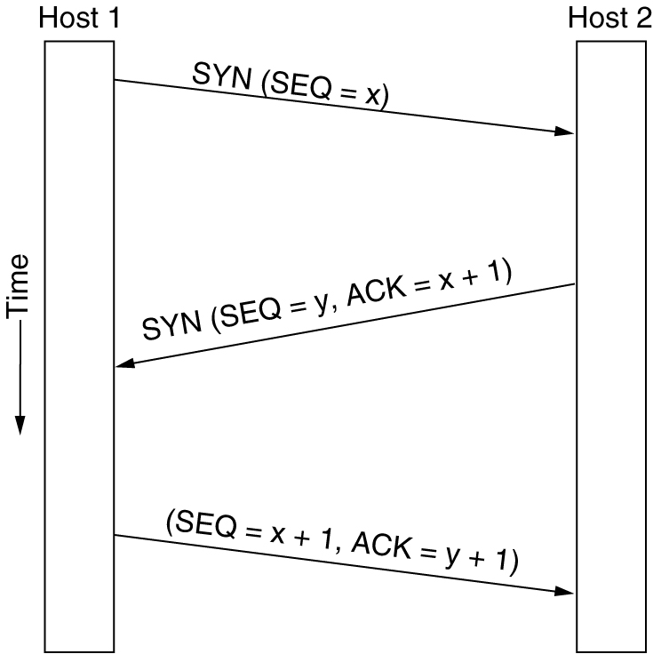
TCP Connection Management
Three way handshake:
Step 1: client host sends TCP SYN segment to server
specifies initial seq #
no data
Step 2: server host receives SYN, replies with SYN-ACK segment
server allocates buffers
specifies server initial seq. #
Step 3: client receives SYN-ACK, replies with ACK segment, which may contain data
client
server

Slide 44
TCP Connection Management (cont.)
Closing a connection:
client closes socket: clientSocket.close();
Step 1: client end system sends TCP FIN control segment to server
Step 2: server receives FIN, replies with ACK. Closes connection, sends FIN.
client
server
close
FIN
ACK
close
FIN

Slide 45
TCP Connection Management (cont.)
Step 3: client receives FIN, replies with ACK.
Enters “timed wait” - will respond with ACK to received FINs
Step 4: server, receives ACK. Connection closed.
client
server
closing
FIN
ACK
closing
FIN
ACK
timed wait
closed
closed

Slide 46
Transport Control Protocol (TCP)
point-to-point:
one sender, one receiver
reliable, in-order byte steam:
no “message boundaries”
pipelined:
TCP congestion and flow control set window size
send & receive buffers
full duplex data:
bi-directional data flow in same connection
MSS: maximum segment size
connection-oriented:
handshaking (exchange of control msgs) init’s sender, receiver state before data exchange
flow controlled:
sender will not overwhelm receiver

Slide 47
Transport Layer Part II: TCP

